Slide 1
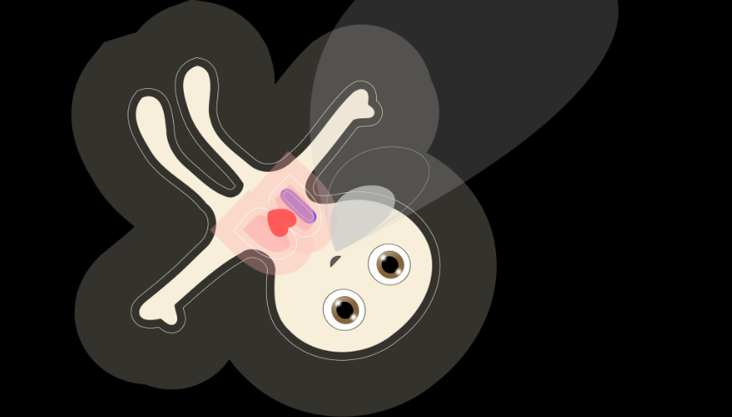

Kurzpräsentation Philips
20.09.2017 / 1130h
zuhanden Herr Dr. Bauer und Herrn Dr. Nürnberg, Philips Schweiz
Visual Patient
A Revolution in Patient Monitoring

Slide 2
  Sequence of presentation
Visual Patient
A Revolution in Patient Monitoring.
1) Begrüssung (3’)
2) Präsentation: Problem, Lösungsansatz, erster Einblick in
den VP (8’)
3) Kurzes Schulungsvideo (3’)
4) Test, Szene im OP, zwei Szenarios (5’)
5) Test IPS (1’)
6) Kurze Vorstellung der Studien (10’)
7) Fragen, Diskussion (30’)

Slide 3
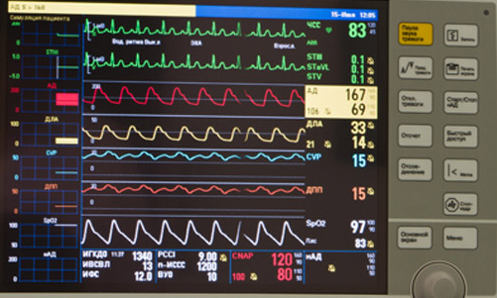
  Why the Technology is needed
Visual Patient
A Revolution in Patient Monitoring.

Slide 4
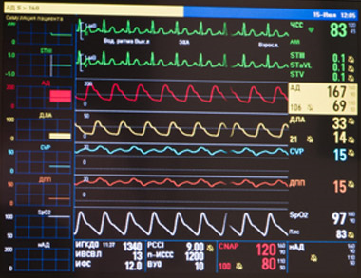
  Why the Technology is needed
Visual Patient
A Revolution in Patient Monitoring.
Too much data, not enough organized information
Situation awareness incomplete
Logical next step in Patient Monitoring
  A revolutionary, easy to learn, new technology that will improve patient safety by making Patient Monitoring much more intuitive.

Slide 5
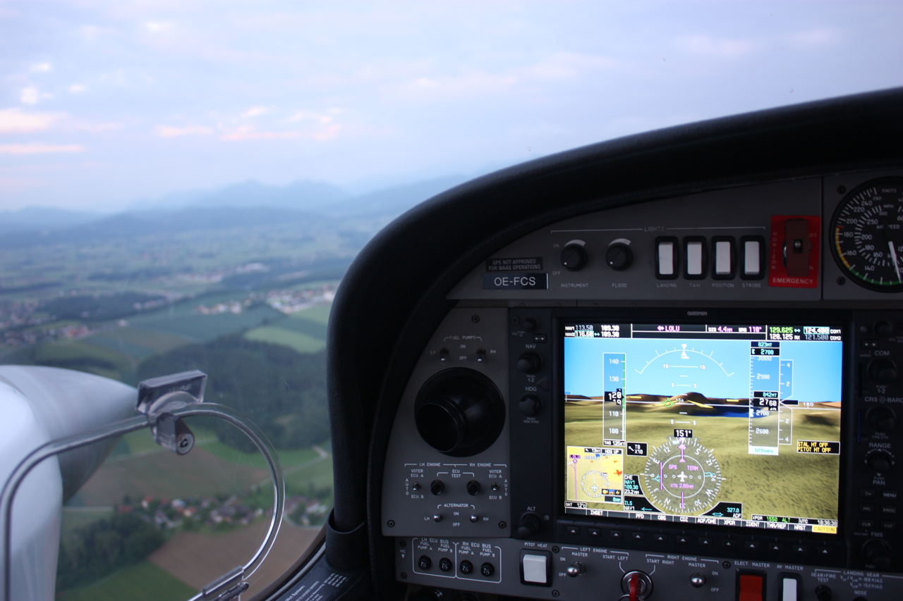
Visual Patient
A Revolution in Patient Monitoring.
Notes:
Hast Du hier noch ein high Res Photo von Dir Pati? We know medicine, flying and programming

Slide 6
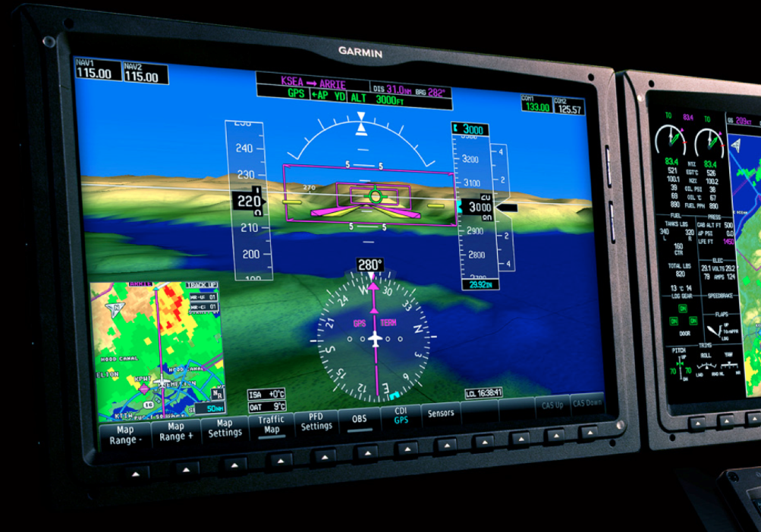
  Visual Patient Technology
Visual Patient
A Revolution in Patient Monitoring.
It’s like looking through the Primary Flight Display to monitor your flight situation – without struggling to piece together a mental picture solely from raw instrument data on the panel.

Slide 7
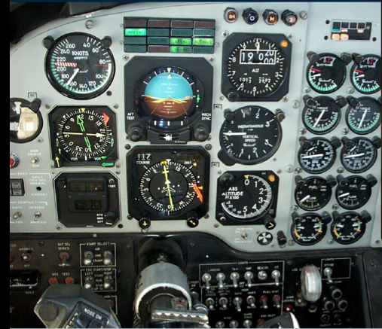
  Visual Patient Technology
Visual Patient
A Revolution in Patient Monitoring.
Classic cockpit instrument panel. Analog instruments.
“The human brain needs to abstract raw data to information and further integrate the information into structured information, which forms the basis of situational awareness”.

Slide 8
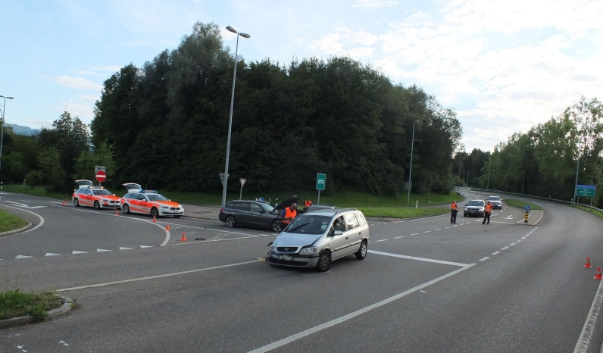
Beispiel Verkehrsunfall
Rapperswil-Jona/SG. Am Samstag (06.08.2016), um 18:10 Uhr, hat ein 49-jähriger Autofahrer an der Rütistrasse ein entgegenkommendes Auto übersehen. Der Mann wollte nach links abbiegen, wobei es zu einer Kollision kam. Die 26-jährige Beifahrerin des entgegen-kommenden Autos verletzte sich dabei leicht. - Kapo SG/PN

Slide 9
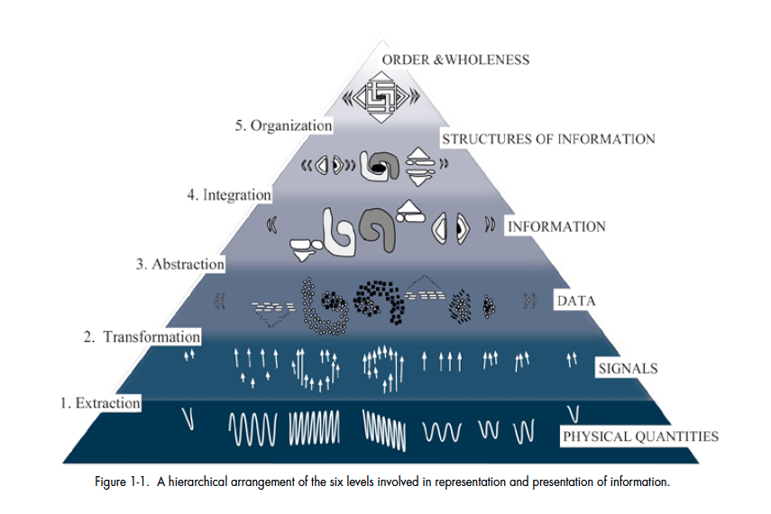
  Why the Technology is needed
Visual Patient
A Revolution in Patient Monitoring.
Visual Patient
Conventional monitoring

Slide 10
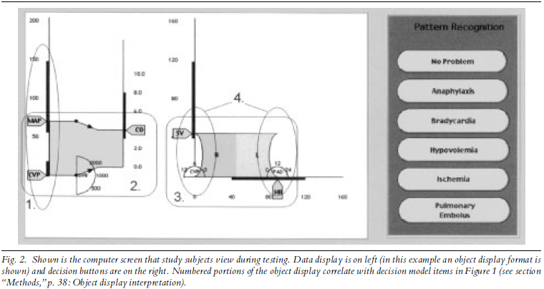
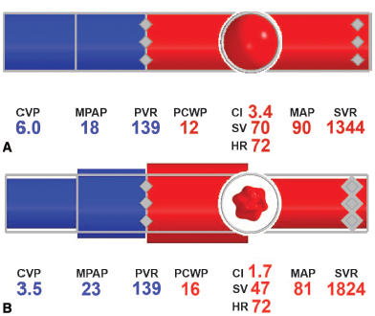
  How should that look like?
Visual Patient
A Revolution in Patient Monitoring.
A GRAPHICAL OBJECT DISPLAY IMPROVES
ANESTHESIOLOGISTS' PERFORMANCE ON A
SIMULATED DIAGNOSTIC TASK
George T. Blike et al.
Journal of Clinical Monitoring and Computing 15: 37-44, 1999
A Simulation-Based Evaluation of a Graphic
Cardiovascular Display
Albert RW, Agutter JA, et al.
Anesth Analg 2007;105:1303–11

Slide 11
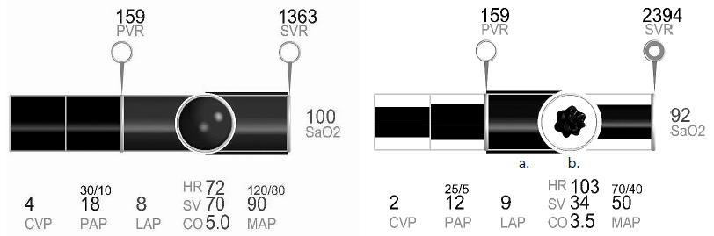
  How should that look like?
Visual Patient
A Revolution in Patient Monitoring.
The Right Picture Is Worth a Thousand Numbers: Data Displays in Anesthesia
Frank A. Drews and Dwayne R. Westenskow, University of Utah, Salt Lake City, Utah
HUMAN FACTORS, Vol. 48, No. 1, Spring 2006, pp. 59–71
Objective: To review the literature on data displays in anesthesia identifying issues and developing design recommendations.
Background: Unexpected incidents are common in critical care medicine. Adverse outcomes are frequently the catastrophic endpoints of an “evolving” chain of subtle incidents. One strategy to reduce the likelihood of an adverse patient outcome during anesthesia is to improve the anesthesiologist’s
ability to detect, diagnose, and treat critical incidents.
Method: A literature review and analysis of data displays.
Results: Current numerical and waveform displays do not support anesthesiologists optimally. An alternative is graphical displays that functionally integrate variables into objects.

Slide 12
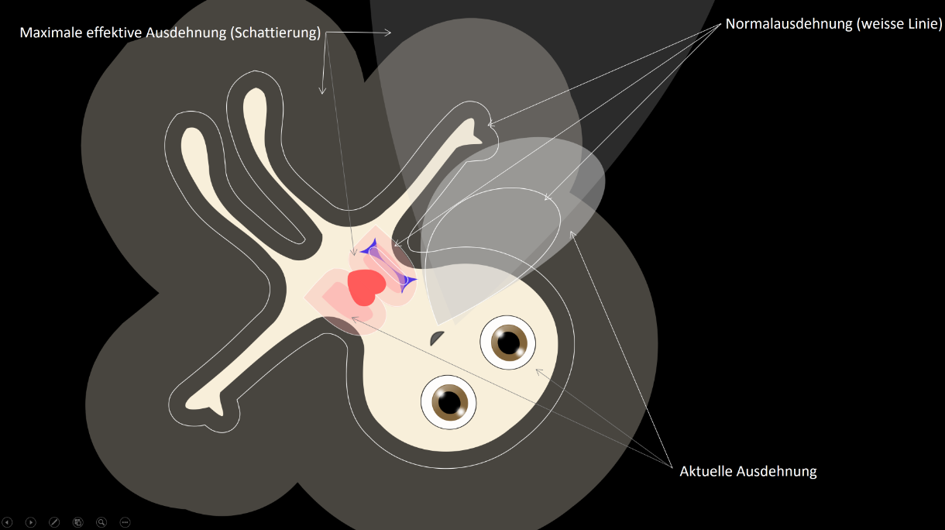
  How should that look like?
  -> I N T U I T I V E
Visual Patient
A Revolution in Patient Monitoring.

Slide 13
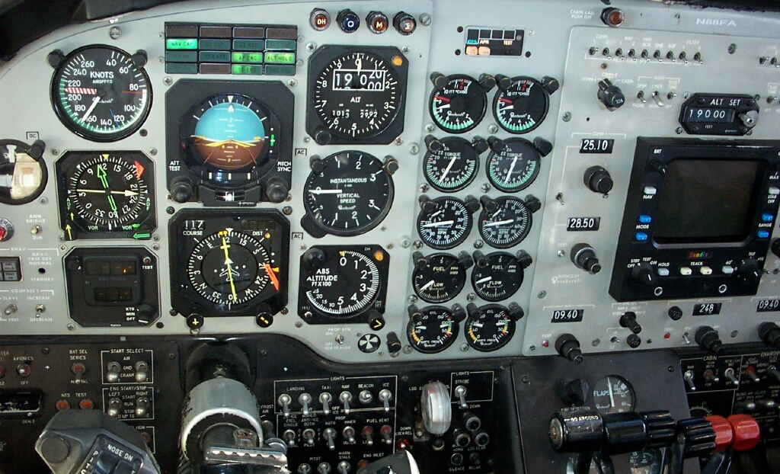
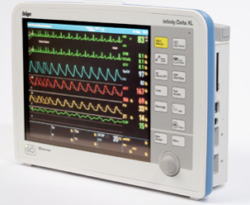
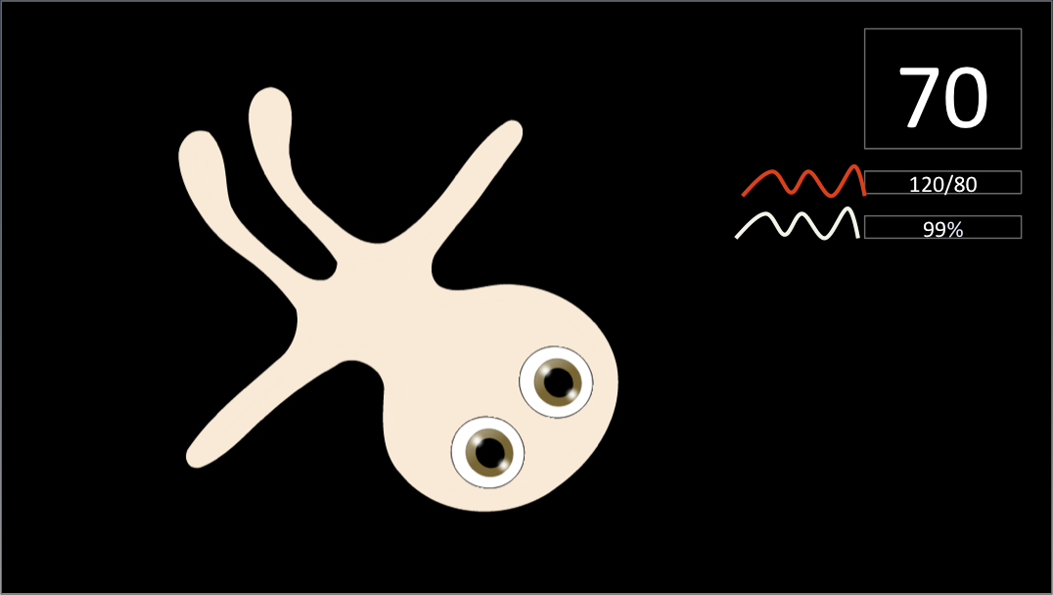
  Visual Patient Technology
Visual Patient
A Revolution in Patient Monitoring.
Classic and new Technology
Revolutionized aviation industry in 10 years
2002
2012
Will revolutionize Patient Monitoring
2017
20??
Notes:
Herz noch einbauen und Lungen beim Mandl

Slide 14
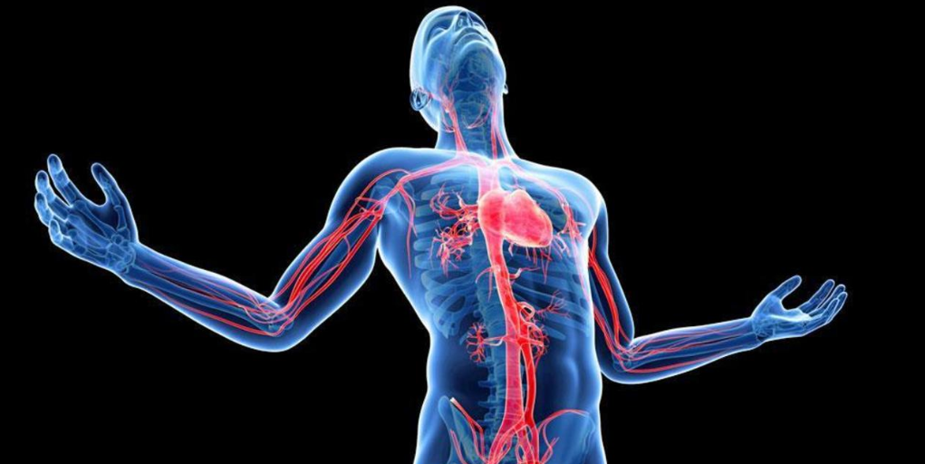
Visual Patient
A Revolution in Patient Monitoring.
www.bbc.com

